Slide 1
EMPLOYEE DATA ANALYSIS IN EXCEL
NAME : ANANDHI S
REGISTER NO : 312209887
DEPARTMENT : B.COM BANK MANAGEMENT
COLLEGE NAME : VALLIAMMAL COLLEGE FOR WOMEN

Slide 2
PROJECT TITILE
EMPLOYEE DATA ANALYSIS IN EXCEL

Slide 3
AGENDA
PROBLEM STATEMENT
PROJECT OVERVIEW
END USERS
OUR SOLUTION AND PROPOSITION
DATASET DESCRIPTION
MODELLING APPROACH
RESULTS AND DISCUSSION
CONCLUSION

Slide 4
PROBLEM STATEMENT
Utilize excel to efficiently analyse employee data by leveraging function such as pivot table and conditional formatting.
The enables the identification of key trends, such as current employees rates, performance levels
Decision making processes by visualization this data through pie chart

Slide 5
PROJECT OVERVIEW
This project focuses on analysing employee data to identify trends and insights that can drive better decision.
Excel helps to collect, clean, organize and visualize the employee business units.
This project analysis highlights the number of employee in a every single business units.
The visualize is easy to separate the data through the gender filter.
The aim of this project to support the strategic planning.

Slide 6


WHO ARE THE END USERS?
The end users of the employee data analysis are human resources manger leads and senior management.

Slide 7
OUR SOLUTION AND ITS VALUE PROPOSITION
CONDITIONAL FORMATTING : Highlights missing cells
FILTER : Helps to remove the empty cells
PIVOT TABLE : Helps to summarize
PIVOT CHART : Helps to visualize

Slide 8
DATASET DESCRIPTION
EMPLOYEE ID
EMPLOYEE TYPE
WORK LOCATION
GENDER
SALARY
EMPLOYEE NAME
START DATE
FTE

Slide 9
THE “WOW” IN OUR SOLUTION
CONDITIONAL FORMATTING:
It helps in filling the colour in missing cells
FILTER BY COLOUR:
It filter the missing cells by removing the colored cells
PIVOT CHART:
It helps to visualize the data in simple way

Slide 10
MODELLING
DATA COLLECTION
Identification
gathering
preparation
DATA CLEANING
Standardization data
correction
validation
SUMMARY
Data analysis involves examine ,transforming, and modelling data to extract insights, identify patterns, and support decision-making skills.

Slide 11
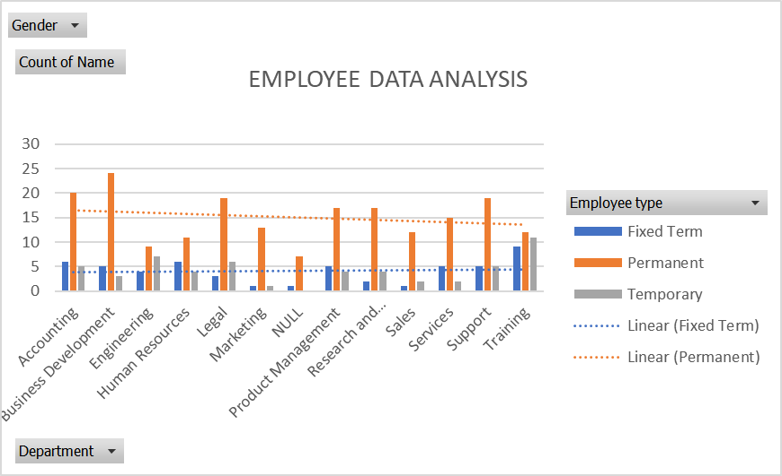
RESULTS

Slide 12
CONCLUSION
In conclusion, the employee data analysis conducted using excel provided valuable insights into workforce trends enabling more informed decision making.
The use of excel allowed efficient data organizing, visualizing and representing the employee data, ultimately this data is helpful to enhance hr strategies, improve employee information clear and helps for optimum performance.

Slide 13


